Slide 1
SIMPLE PRESENT TENSE

Slide 2
STRUCTURE OF SIMPLE PRESENT TENSE
.
SUBJECT+VERB SUBJECT+VERB+S/ES/IES
I
He
We
You
They
+
go
She
+ goes
It

Slide 3
USES OF SIMPLE PRESENT TENSE
To talk about :
Daily routine
Regular and repeated actions
Likes and dislikes
General facts
Universal truths

Slide 4
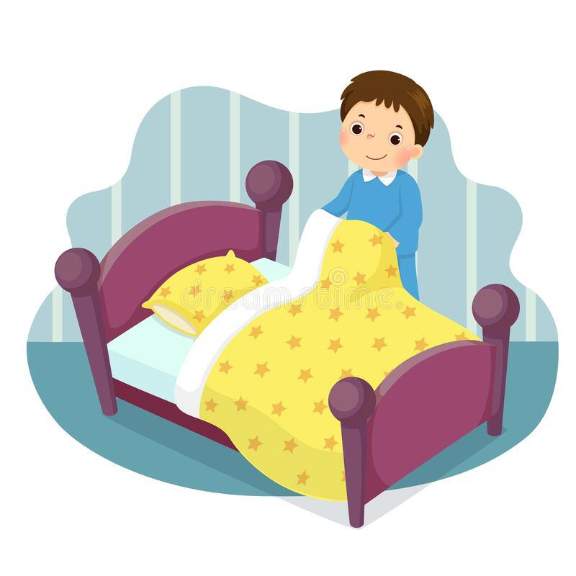
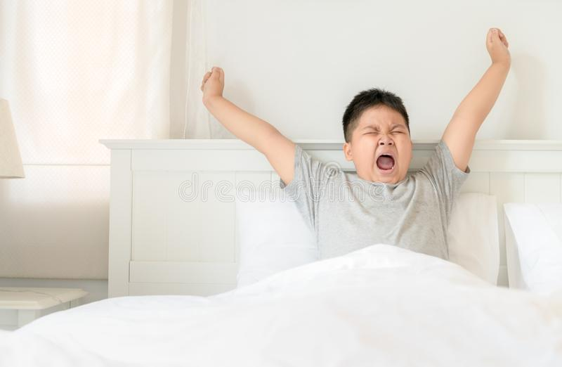
DAILY ROUTINE
I wake up at 6 am every day. I make the bed.

Slide 5
DAILY ROUTINE
I go for a walk every morning. My father reads the newspaper.

Slide 6
DAILY ROUTINE
I wake up at 6 am every day. I brush my teeth as soon as I wakeup.

Slide 7
DAILY ROUTINE
I wake up at 6 am every day. I brush my teeth as soon as I wakeup.

Slide 10
EXAMPLES
DAILY ROUTINE
I watch TV every day.
She works in a hospital.
The students attend classes every day.
We wake up early every day.
My father reads the newspaper every morning.
I go to bed early every day.
He goes for a walk every morning.
They eat breakfast at 8 am.
My mother cooks every day.

Slide 11
EXAMPLES
REGULAR AND REPEATED ACTIONS
We pay our bills every month.
Seasons change every three months.
Elections come every five years.
I receive my salary every month.
I trim my nails once a week.
She washes the clothes once a week.
We go to movies once a month.
They eat out once a week.

Slide 12
EXAMPLES
LIKES AND DISLIKES
I like sweets.

Slide 13
EXAMPLES
GENERAL FACTS

Slide 14
EXAMPLES
UNIVERSAL TRUTHS

Slide 15
EXAMPLES

Slide 16
EXAMPLES

Slide 17
EXAMPLES

Slide 18
STRUCTURE OF SIMPLE PRESENT TENSE
AFFIRMATIVE FORM
.
SUBJECT+VERB SUBJECT+VERB+S/ES/IES

Slide 19
STRUCTURE OF SIMPLE PRESENT TENSE
AFFIRMATIVE FORM
.
SUBJECT+VERB SUBJECT+VERB+S/ES/IES

Slide 20
STRUCTURE OF SIMPLE PRESENT TENSE
AFFIRMATIVE FORM
.
SUBJECT+VERB SUBJECT+VERB+S/ES/IES

Slide 21
STRUCTURE OF SIMPLE PRESENT TENSE
.

Slide 22
STRUCTURE OF SIMPLE PRESENT TENSE
.

Slide 23
STRUCTURE OF SIMPLE PRESENT TENSE
.

